Slide 1
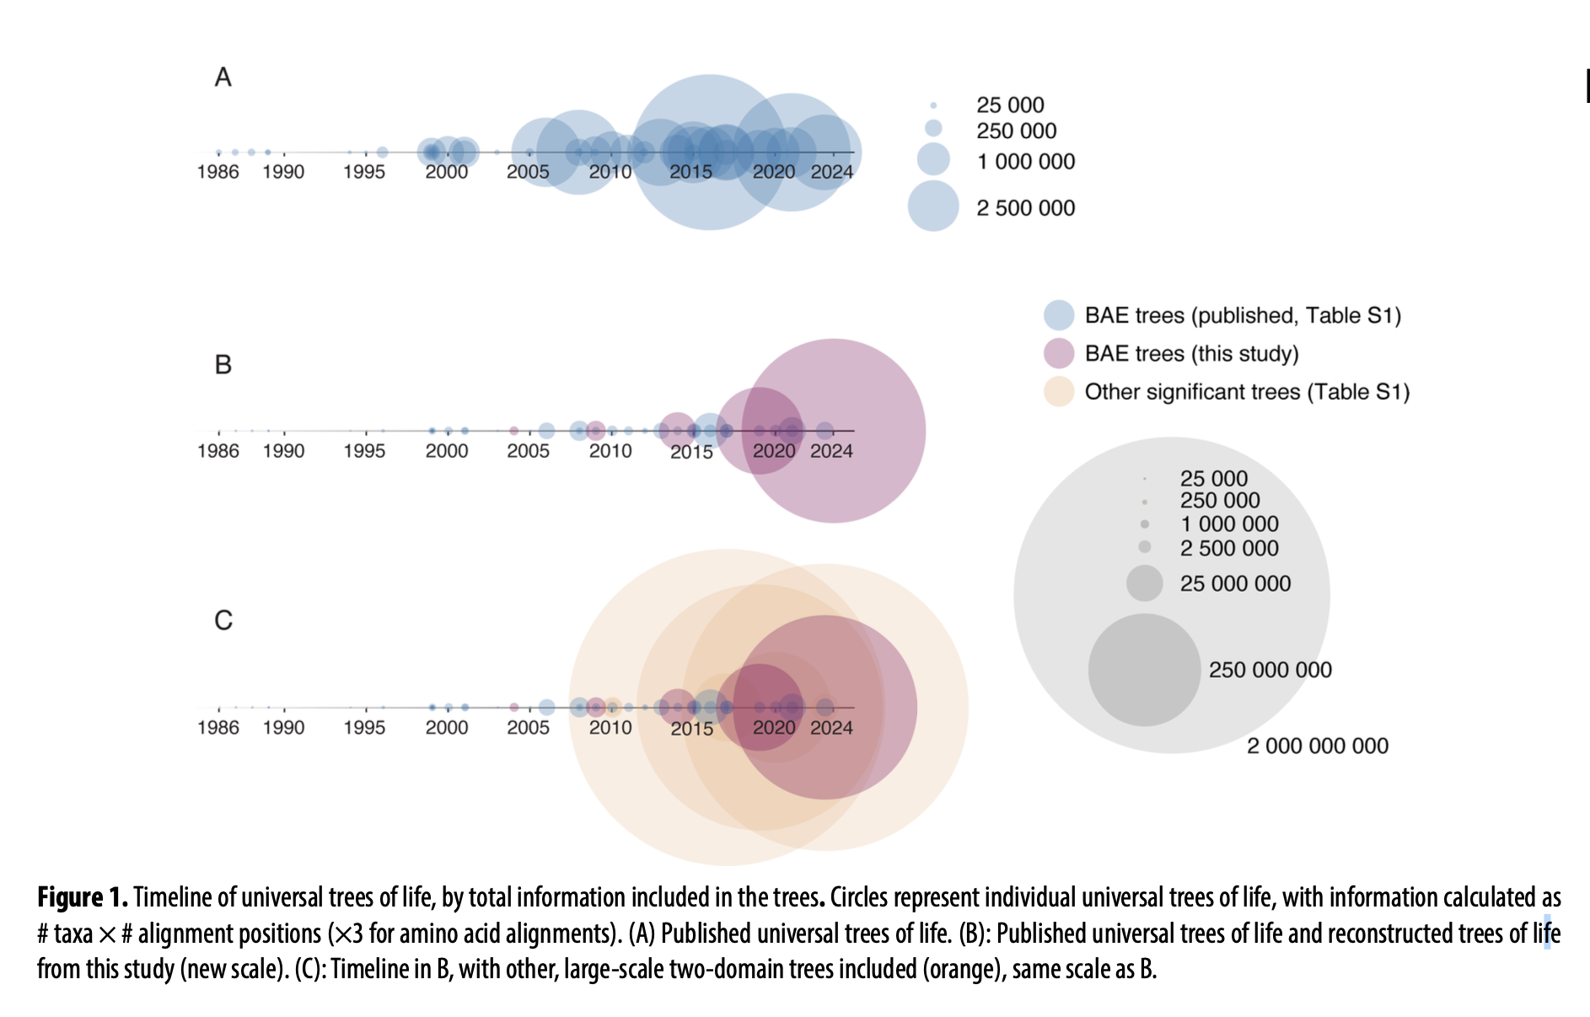
Molly Chen, Artem I. Kholodov and Laura A. Hug (2025). The evolution of the tree of life. Phil. Trans. R. Soc. B 380: 20240091.
https://doi.org/10.1098/rstb.2024.0091
Class focus area: Tree of life and tree metrics
EEB603: Brian O’Meara
All quotes and images from the above paper unless otherwise noted

Slide 2
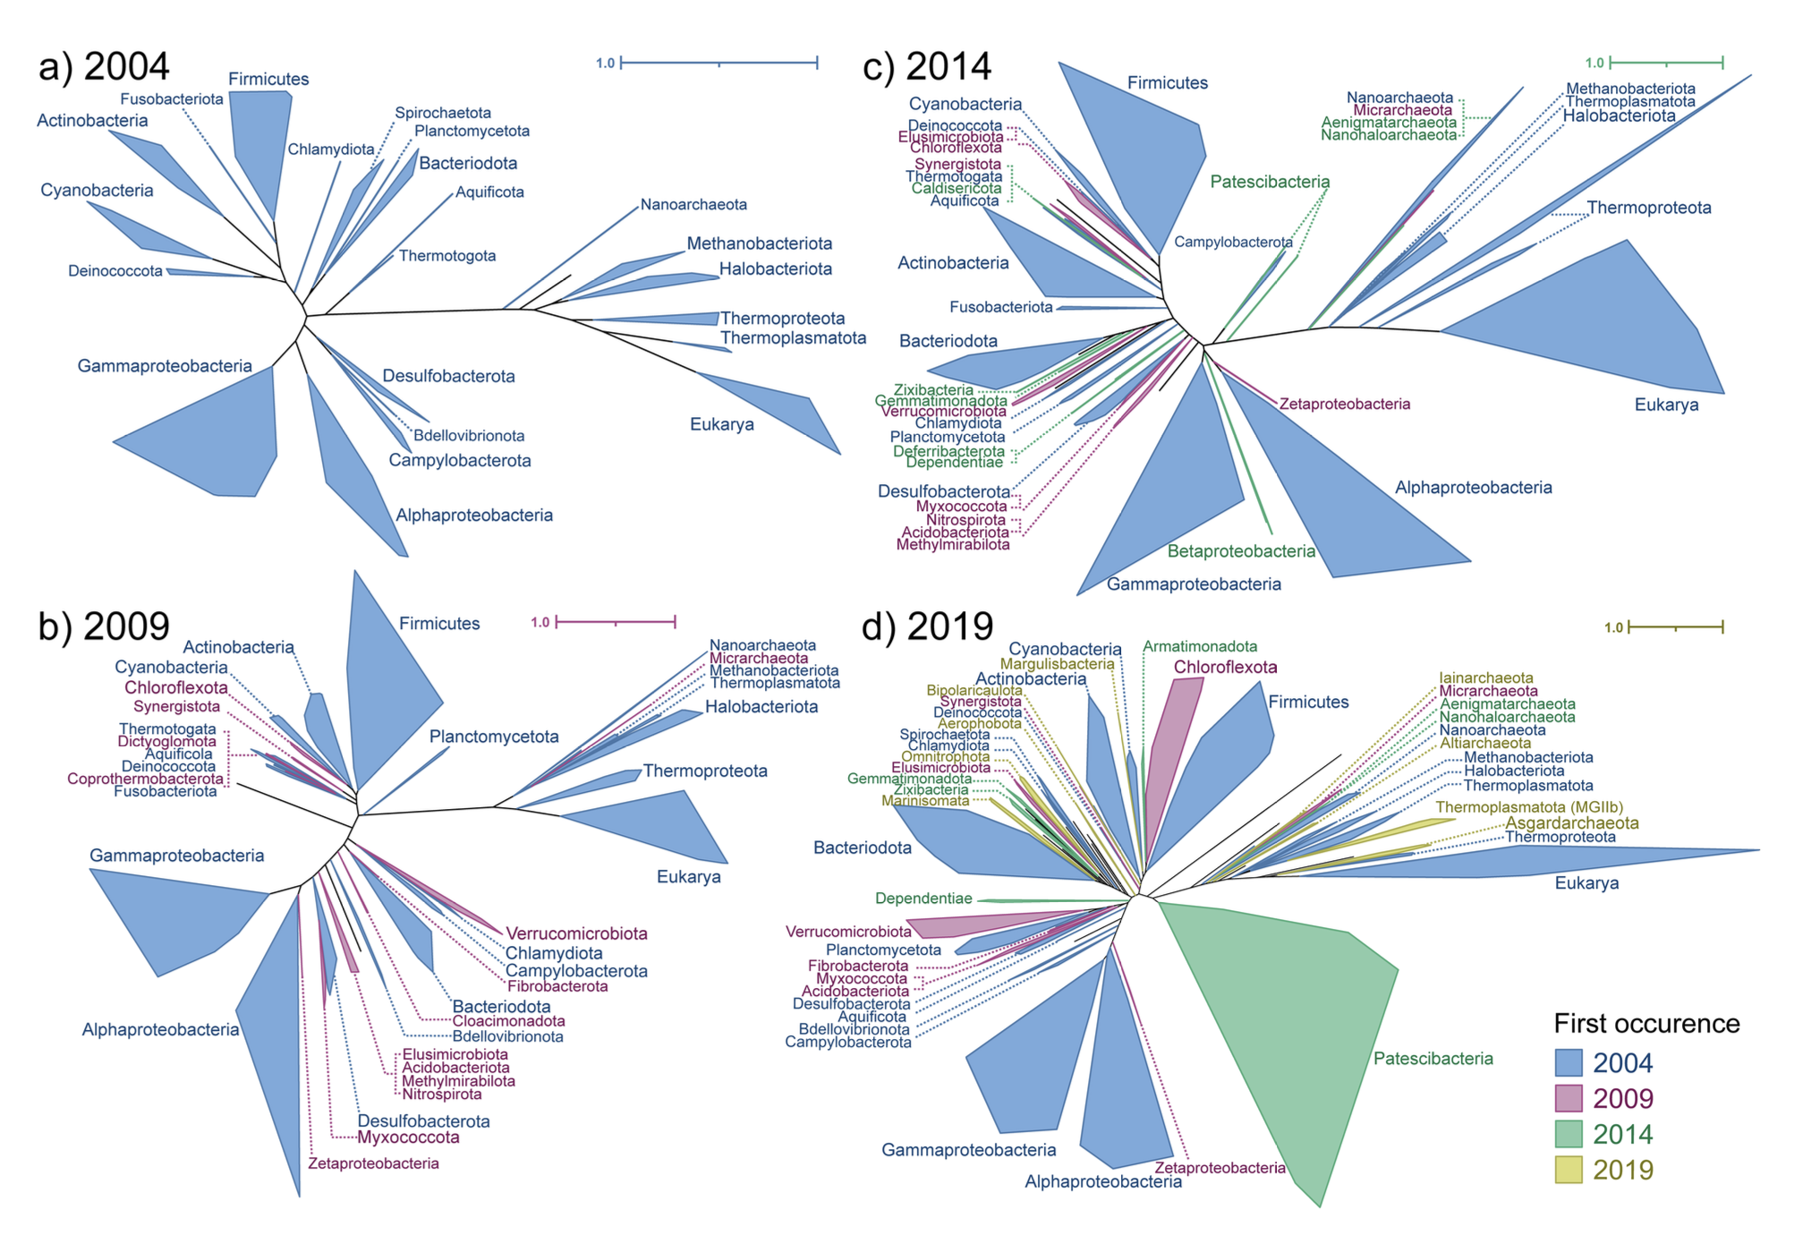

Slide 3
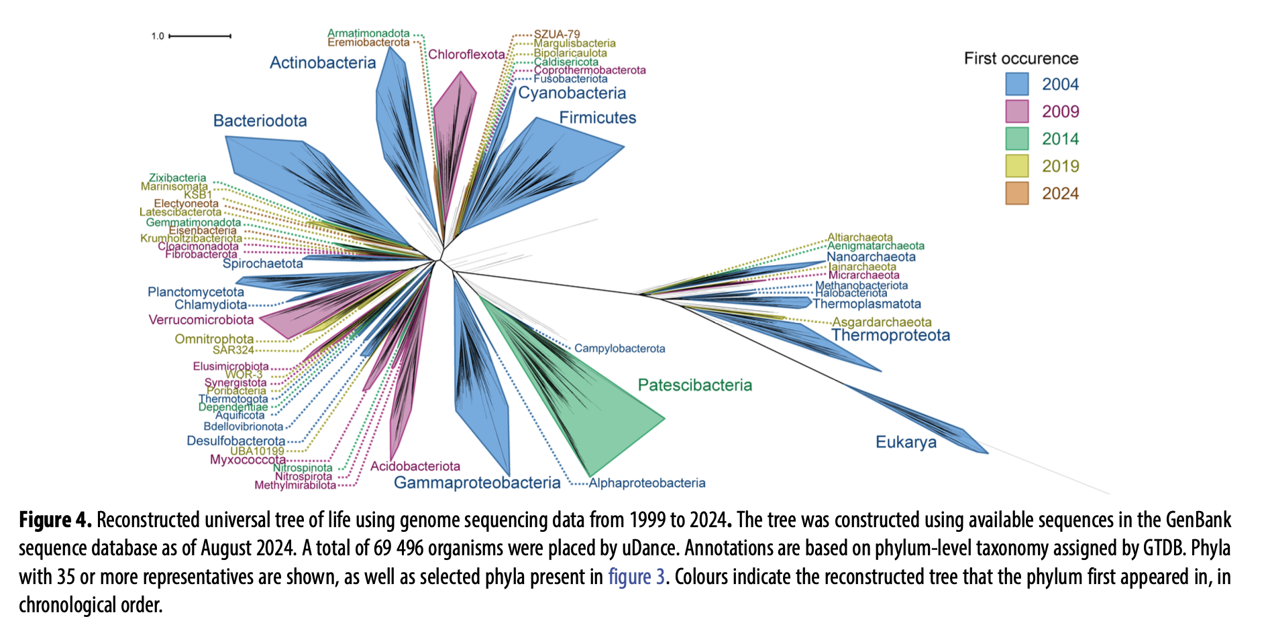

Slide 4
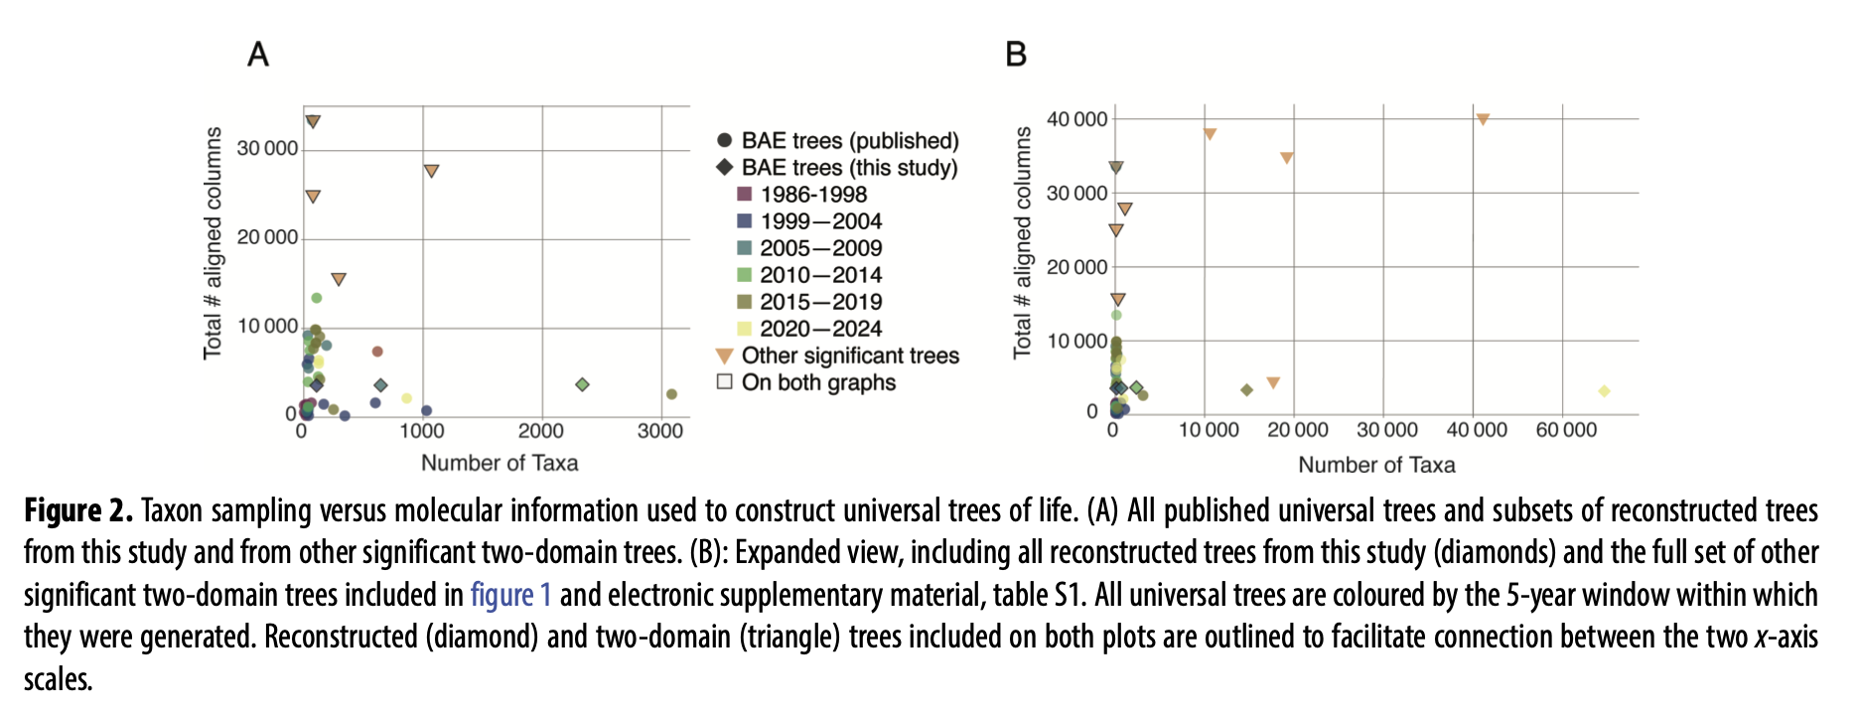

Slide 5
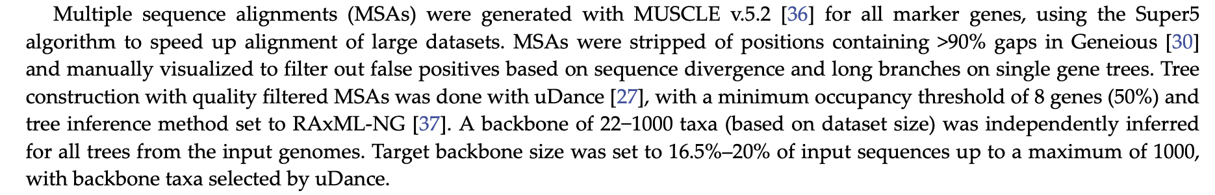
You now know what some of this means! #Learning

Slide 6
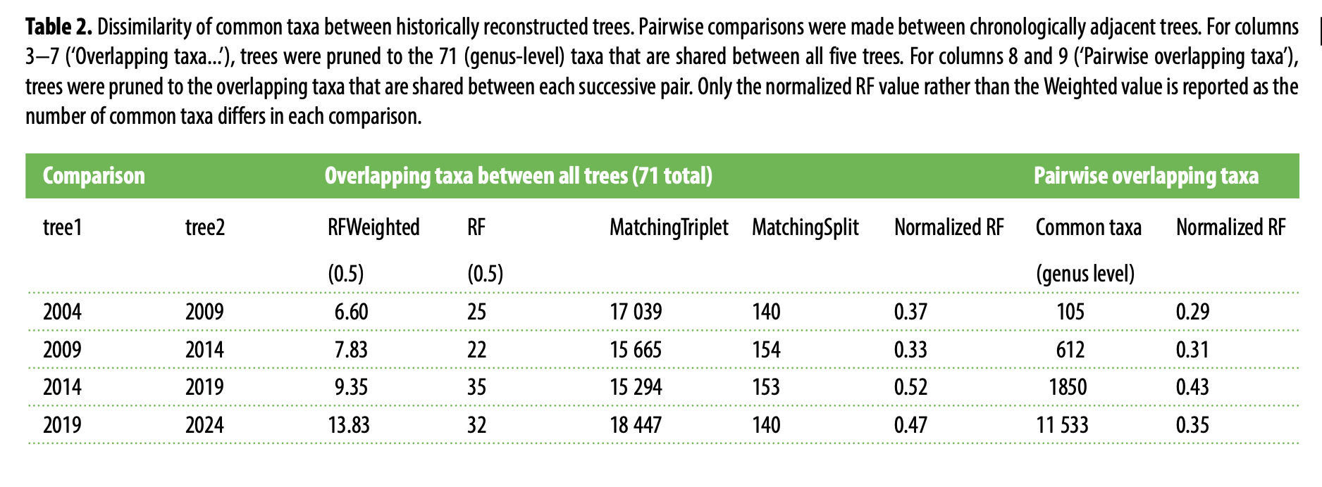

Slide 7
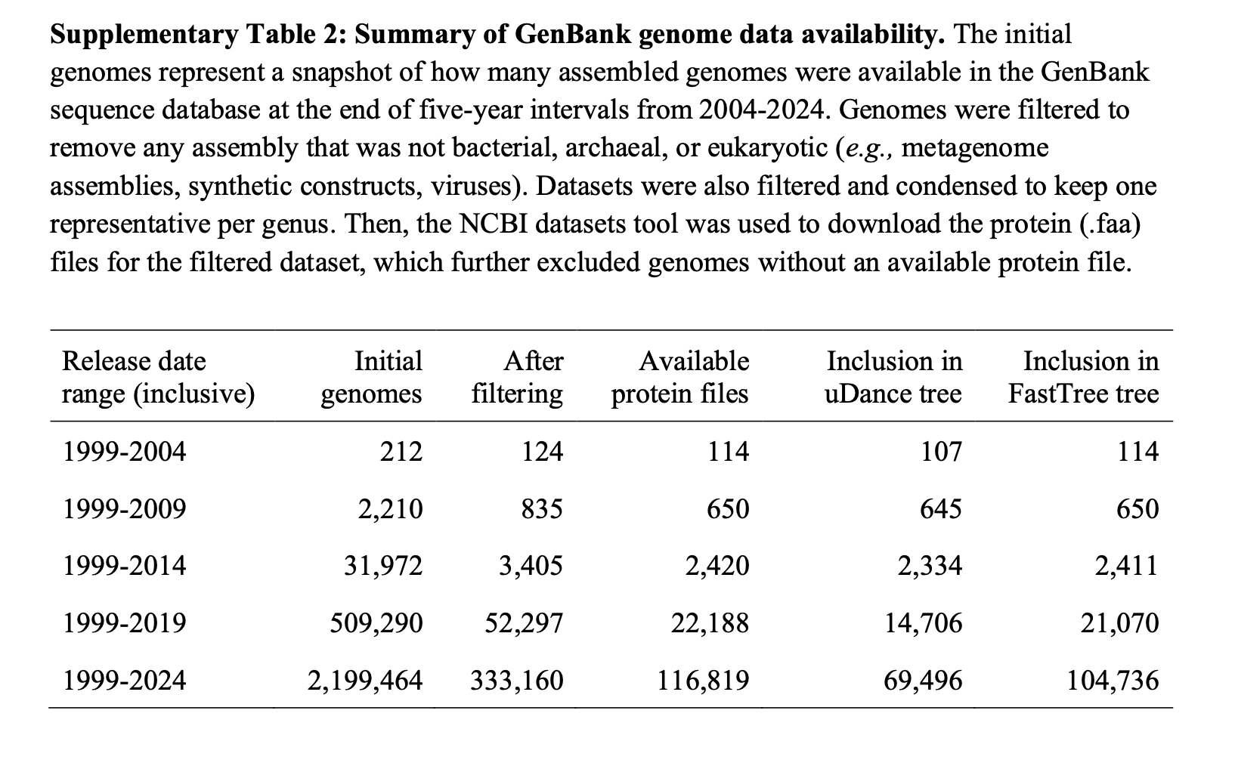

Slide 8
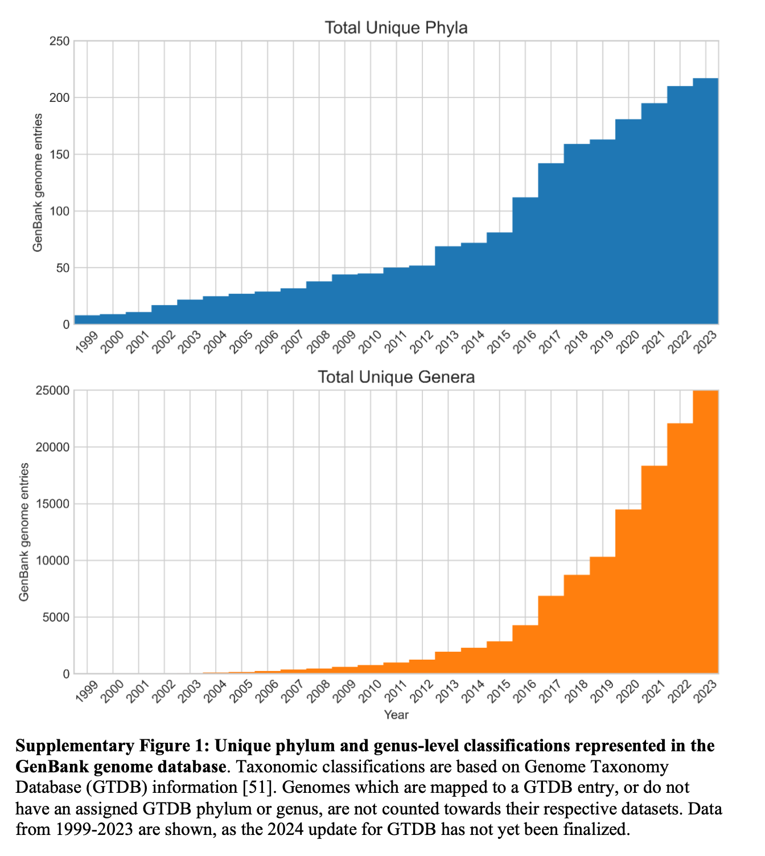

Slide 10
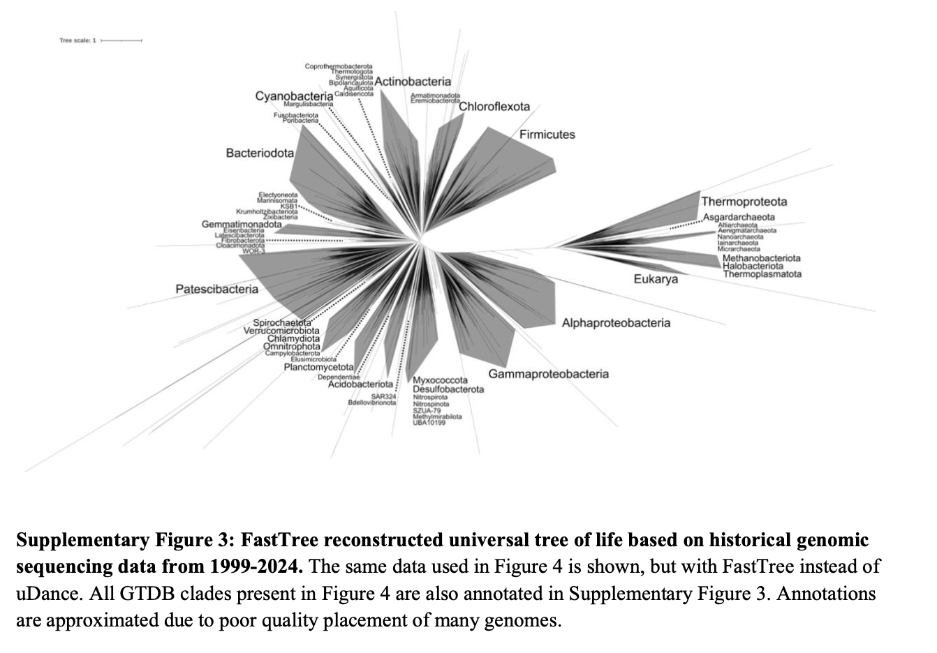

Slide 11
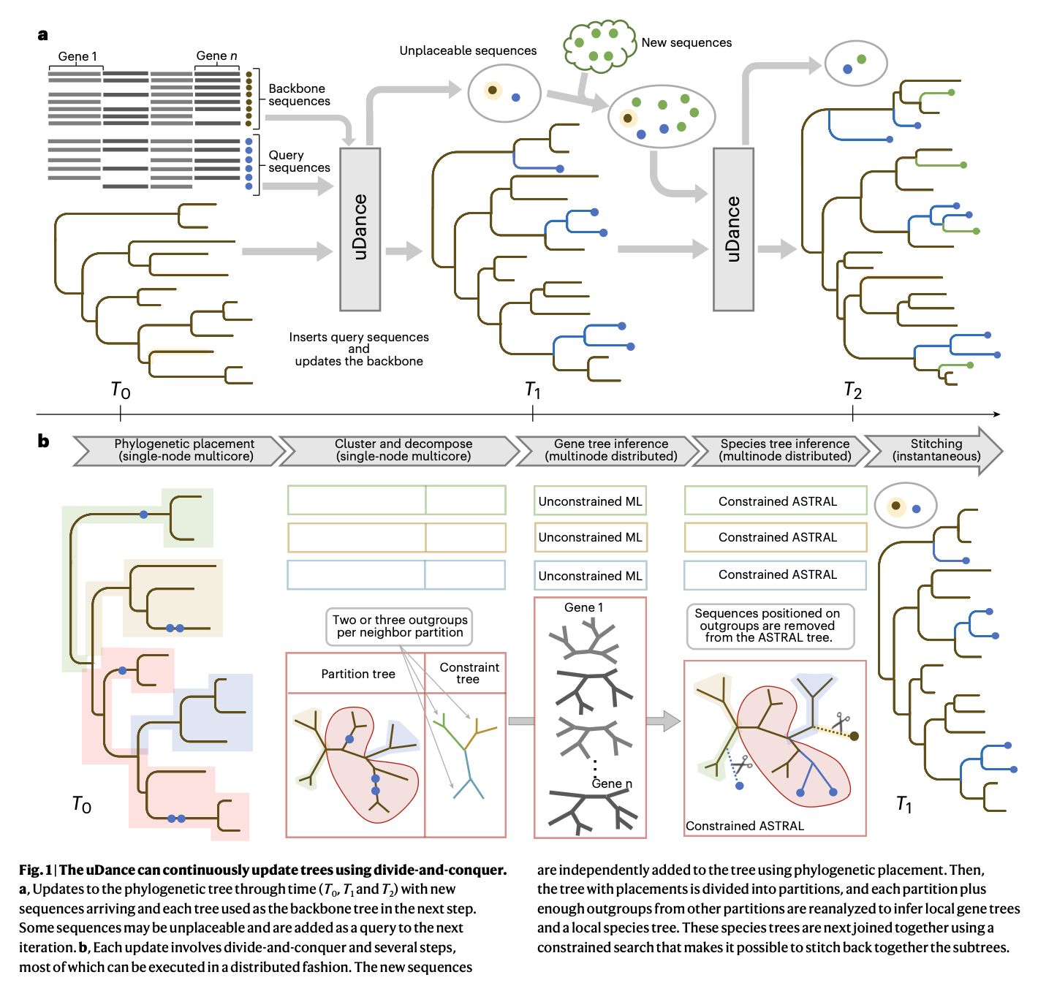
Balaban et al. 2024

Slide 12
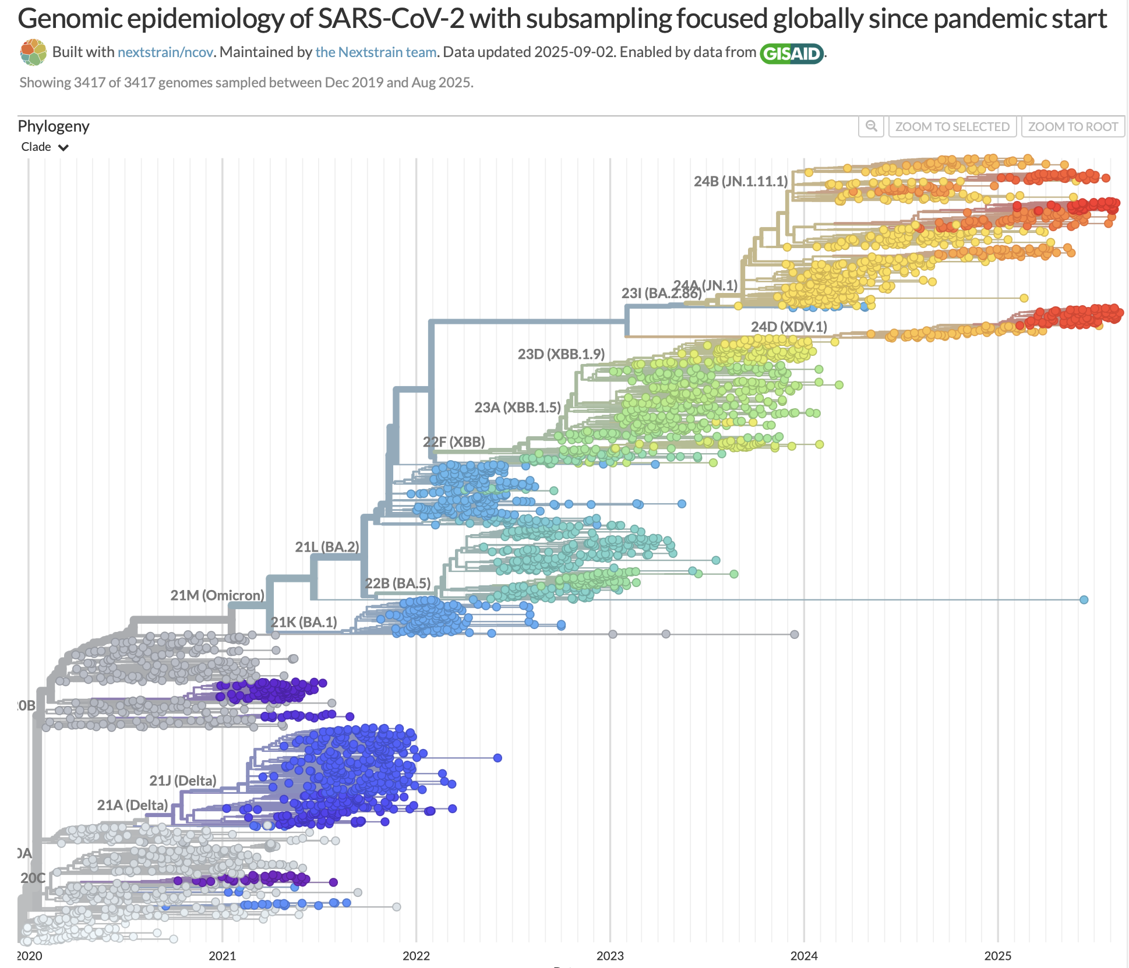
https://nextstrain.org/ncov/gisaid/global/all-time

Slide 13
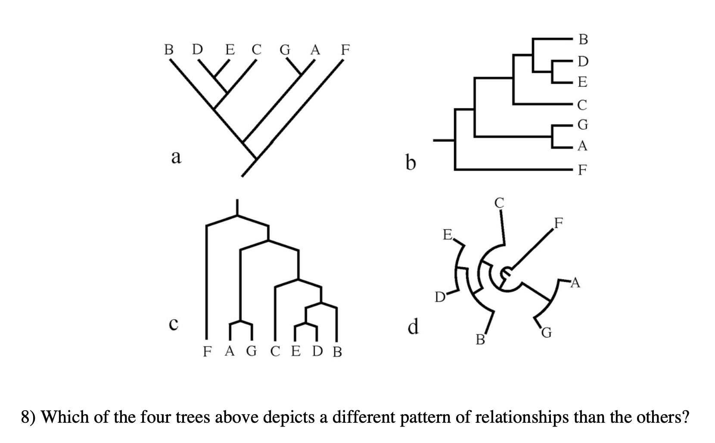
Baum & Smith 2005

Slide 14
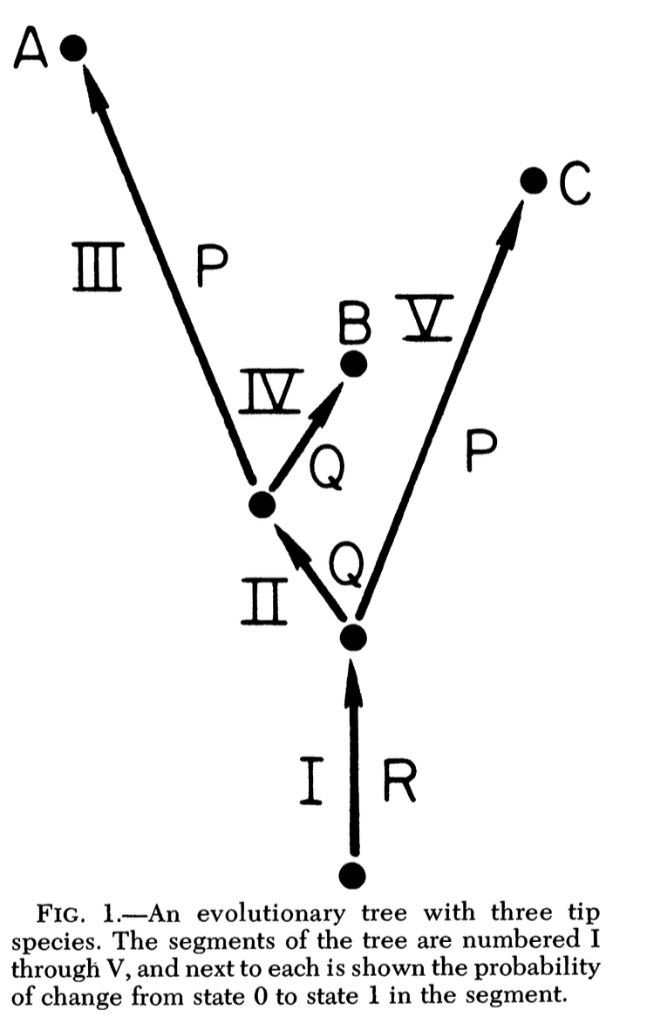
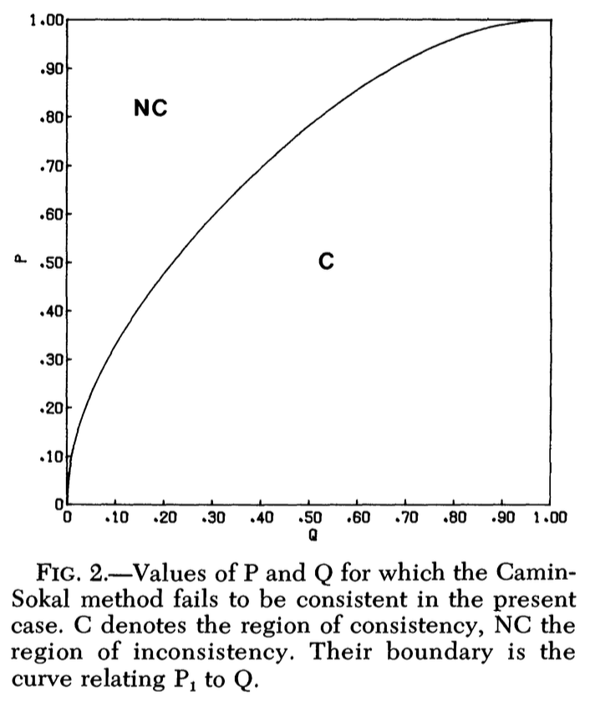
Felsenstein 1978

Slide 15
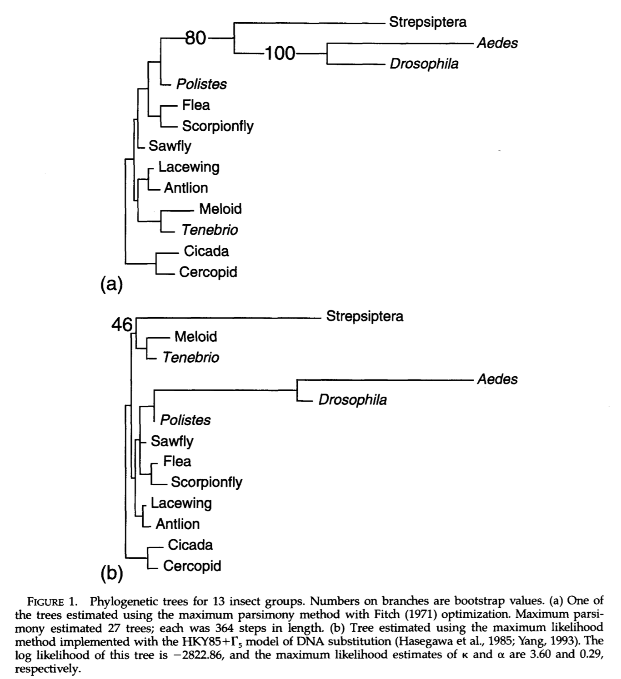
Huelsenbeck 1997

Slide 16
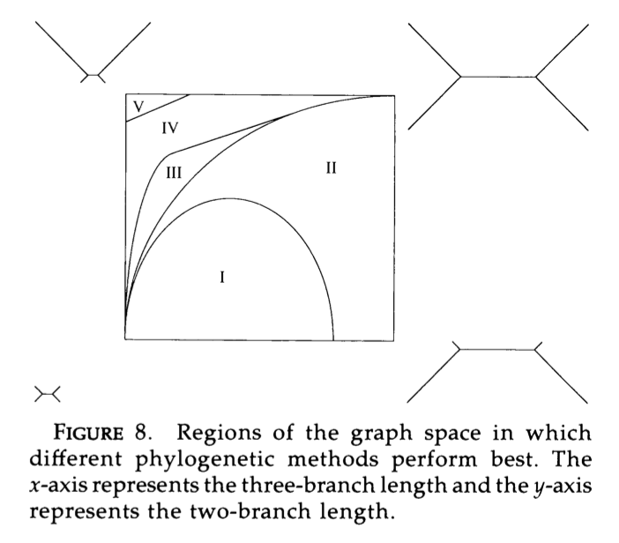
Huelsenbeck and Hillis, 1993

